Slide 1
AI in Autonomous Vehicles -
The Future of Transportation

Slide 2

INTRODUCE THE ERA
Autonomous vehicles are cars that drives themselves using AI and sensors
The technology has evolved
Rapidly in past 2 years

Slide 3
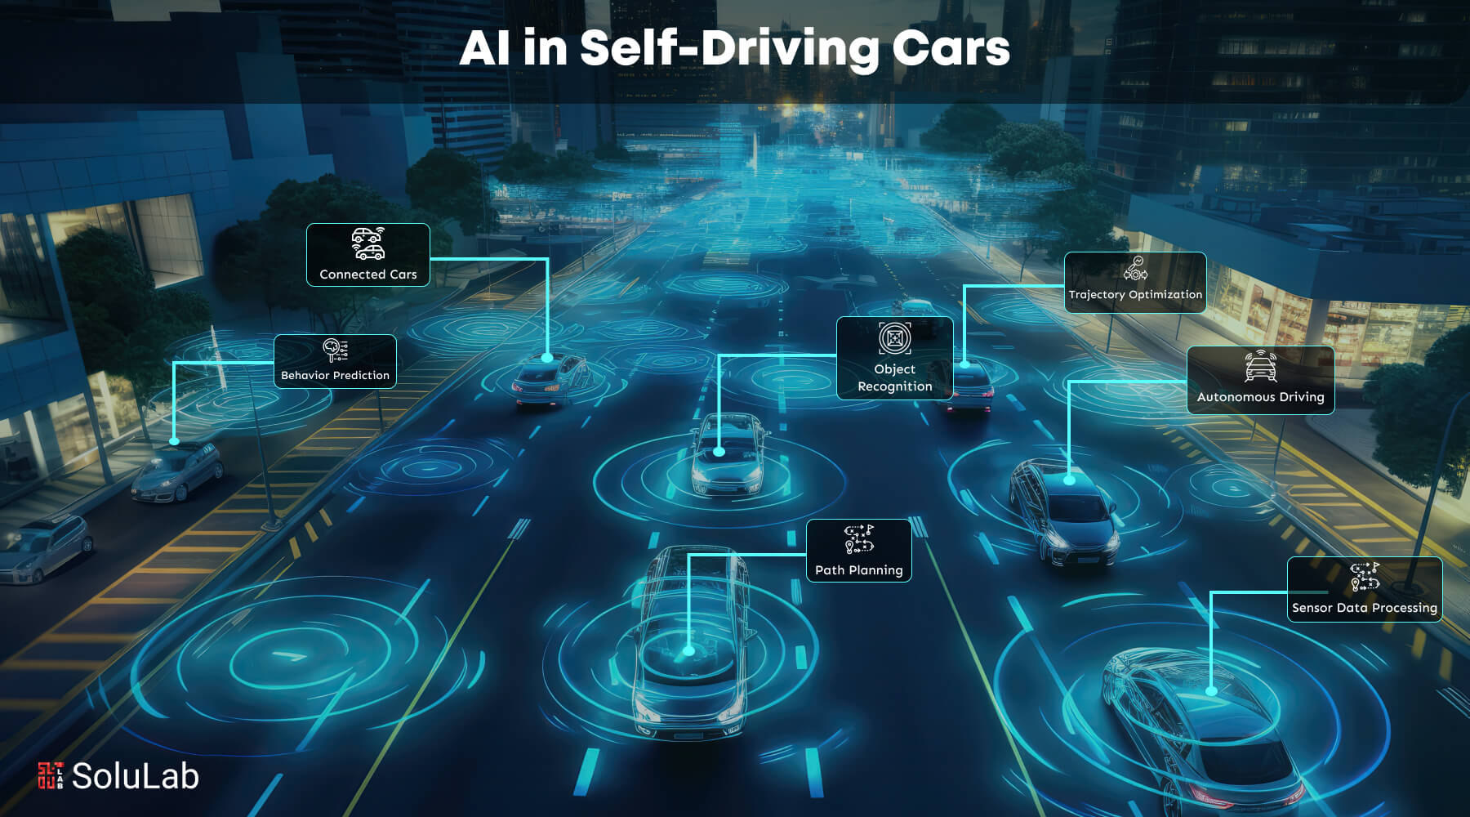
ROLE OF AI
AI helps cars “see” with cameras and sensors.
It processes data to make driving decisions using deep learning and computer vision.
AI predicts the behavior of other road users (like pedestrians and other vehicles) to plan safe maneuver

Slide 4
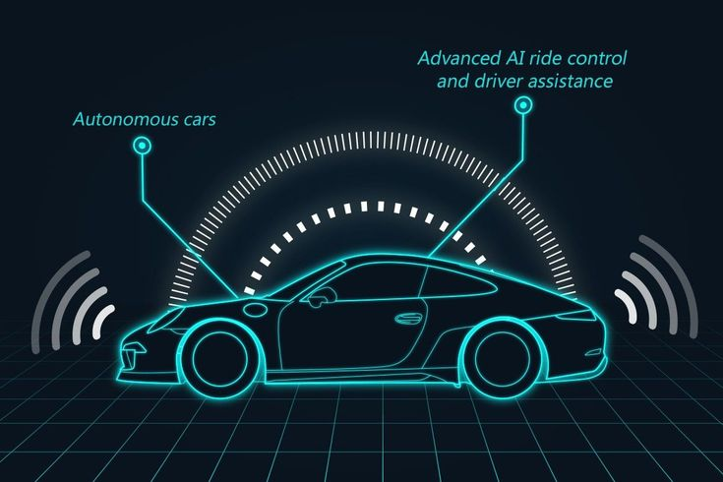
Recent Innovations
Improvements in AI algorithms for safer navigation.
Advanced sensors like LiDAR and radar
Companies like Tesla, Waymo, have tested new self-driving features recently.

Slide 5
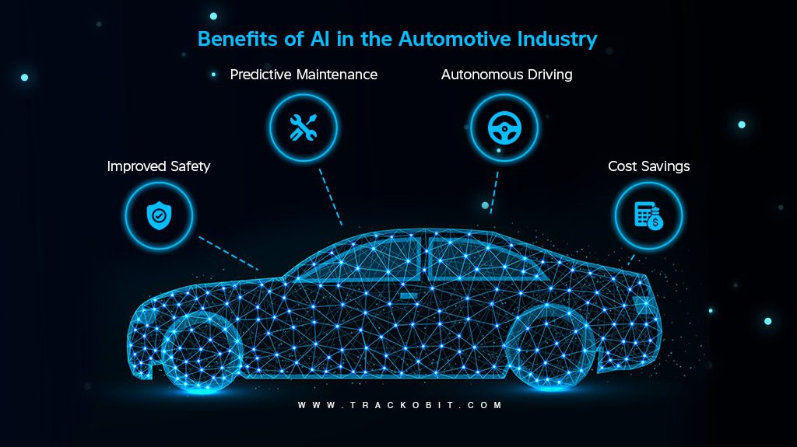
Benefits :
Safer roads by reducing humam errors
Less traffic congestion
Environmental driving on efficient driving
CHALLENGES :
* Handling complex weather and
unpredictable suitation
* Decision making while accidents
HA

Slide 6
Conclusion :
AI is transforming how we travel with safer, smarter cars.
The future of transportation looks autonomous and connected.

Slide 7

Thank you !

